Slide 1

How to Choose A Great Red Wine

Slide 2

Phoebe
Previously a Family and Consumer Sciences teacher
Interested in data analysis for the change in career path and many opportunities !

Slide 3

Tanishia
Served in Non-profit most of my professional career with a focus on development and fundraising
Interested in data analysis for career growth, expansion in salary and a way to tie my love for cultural anthropology, food and data together.

Slide 4
Project Introduction

Slide 5

Background on red wine
Characteristics of Red Wine Drinkers
Willing to spend $40 + dollars on a bottle on wine
Early Bird
More likely to be a “wine aficionado”
More likely to identify as adventurous, humble and organized
Introverted
Prefer dogs to cats
Where are the most popular places for red wine?
Italy,France,Spain,United States, Chile, Australia, China, Germany, South Africa, Portugal, Romania, Russia, Hungary, New Zealand
Why are certain regions better than others?
Regions throughout the Mediterranean, as well as new world regions like California, Chile, and South Eastern Australia. Wines found in Mediterranean climates tend to be fuller bodied with lower acidity, higher alcohol, plus riper tannins and fruit flavors thanks to warmer temperatures.
How does the environment impact the production of red wine?
Agriculture has a big influence on the environment, it contributes to climate change and global warming. With the use of fertilizers, pesticides, soil, land, water, and energy it’s responsible for approximately 20% of all greenhouse gas emissions. And wine production is no exception, the process of growing grapes and transforming it into wine, contributes to those effects as well.

Slide 6

Question 1 : What Factors Determine a Quality Wine ?
Why we chose this question
Let's help solve the age old questions … “what exactly makes a quality wine”. Wine enthusiastic, to novices all have pondered this exact topic. Does one simply Purchase the most expensive bottle, what about sugar content and acidity levels? The dataset analyses 1599 entries from the Portuguese "Vinho Verde" wine set found on Kaggle.

Slide 7
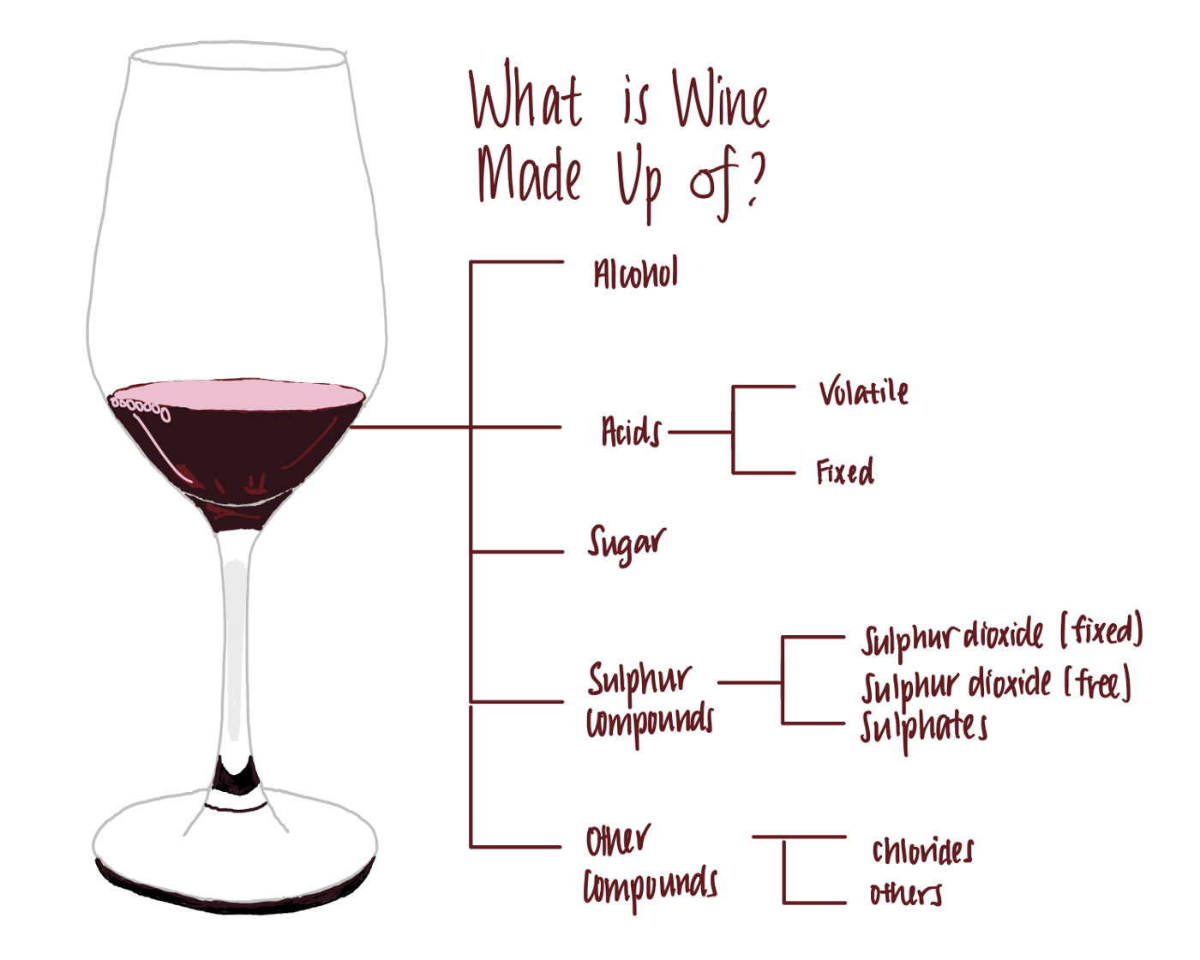
Question 1 : What Factors Determine a Quality Wine ?
The variables were examined in during the process
Fixed acidity
Volatile acidity
Citric acid
Residual sugar
Chlorides
Free sulfur dioxide
Total sulfur dioxide
Density
Ph
Sulphates
Alcohol
Quality

Slide 8
Question 2: Which factor has the most impact on the alcohol percentage in wine ?
Why we chose this question
The variables that went into it

Slide 9
Methods

Slide 10
Next comes your methods section. This is where you talk about all of the details regarding your data. You want to give a very high level overview of what you did to:
Gather/find data
Manipulate / wrangle data
Create new variables
You also want to paint a picture of what your data is like. Include details such as:
Important variables and their summary statistics
Sample size
The methods section should only be a few slides, and should not include any code. You are presenting to a wide, non-data science audience, and thus should not go into a lot of detail.

Slide 11
Question 1 : What Factors Determine a Quality Wine ?
Chi Square Correlation test
Stepwise Regression

Slide 12
Question 2: Which factor has the most impact on the alcohol percentage in wine ?
Stepwise Regression
(Show Code )

Slide 13
Results From Tests

Slide 14
Question 1 : What Factors Determine a Quality Wine ?
Stepwise Regression Results
The variables that impact the quality of the wine is : free sulfur dioxide , pH, total sulfur dioxide, chlorides, sulphates, volatile acidity, and alcohol content
Chi Square Correlation Test
The results produced by the test found that Alcohol and sulphates have the least impact on quality at 0.48% and the variables that impacted quality the most were volatile acidity, chlorides, with sulfur dioxide and density following closely behind.

Slide 15
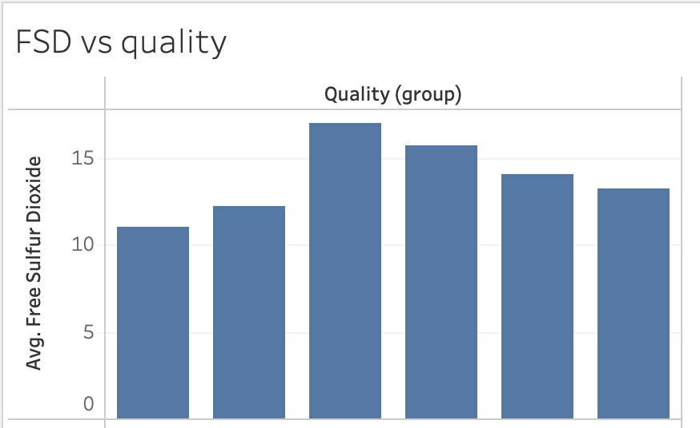
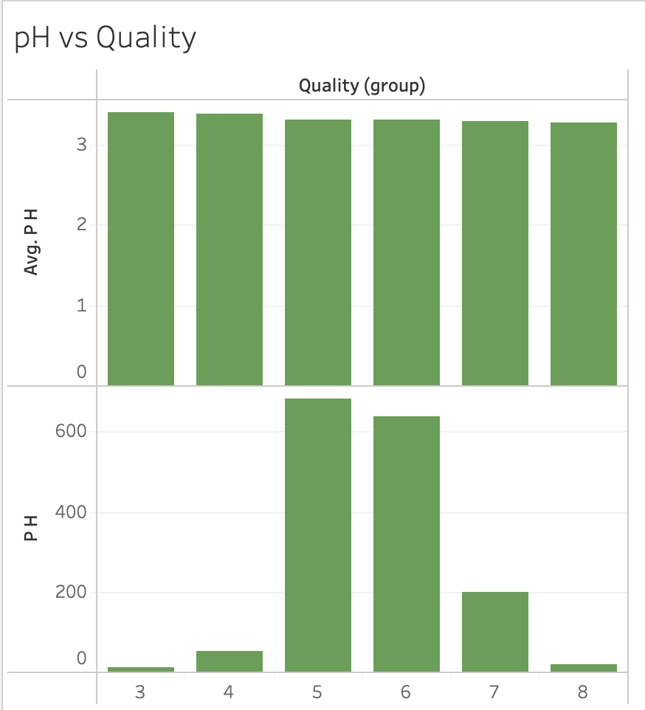
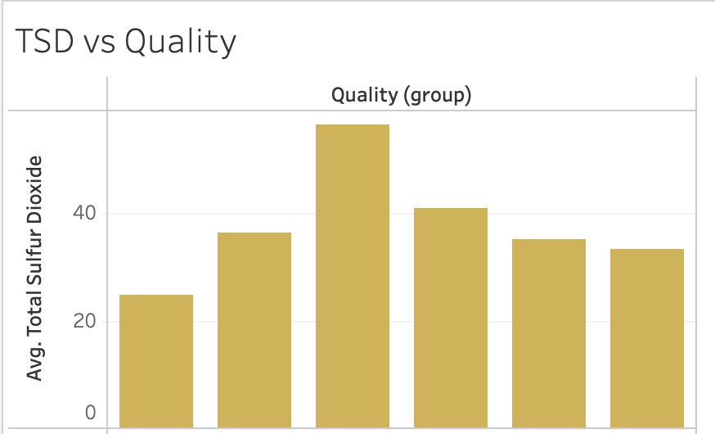
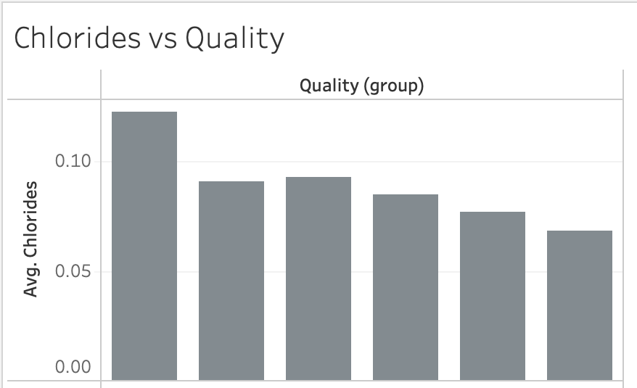
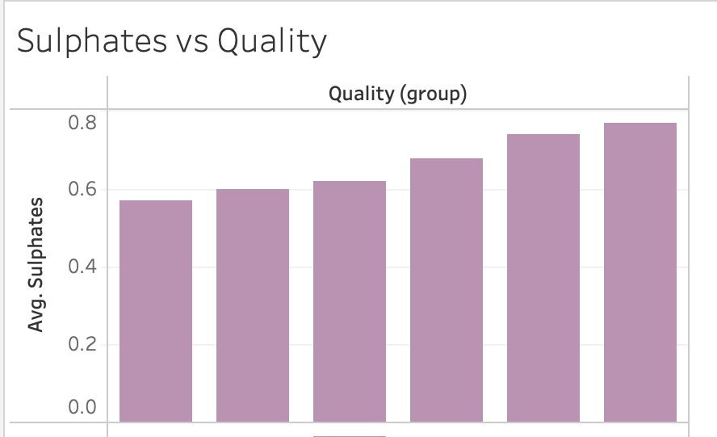
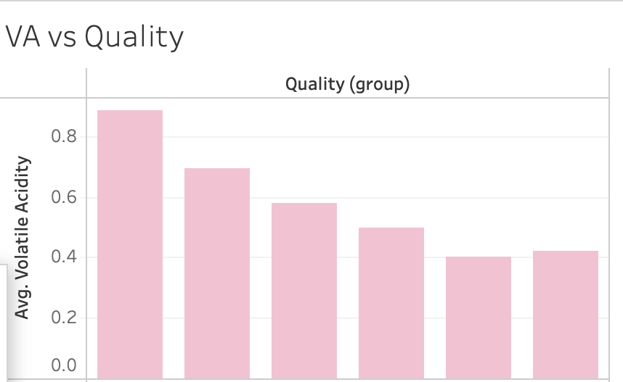
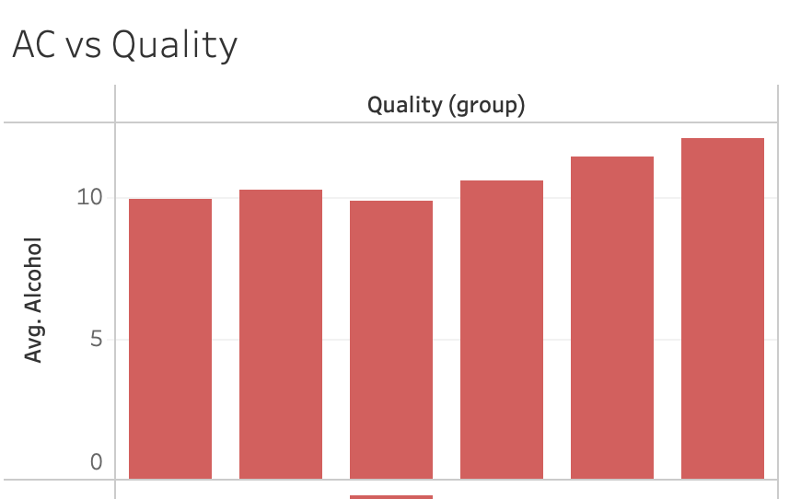
Stepwise Regression Results
Free Sulfur Dioxide
pH
Total Sulfur Dioxide
Chlorides
Sulphates
Volatile Acidity
Alcohol Content
Notes:
Many of the results produced via the Step Regression were similar except we see that there is a large impact the quality and sulfur dioxide, the volatile acidity also shows here that there is a large impact in the quality of the wince when there is less added which is contrary to what was found in the chi-square. he variables that impact the quality of the wine is : free sulfur dioxide , pH, total sulfur dioxide, chlorides, sulphates, volatile acidity, and alcohol content

Slide 16
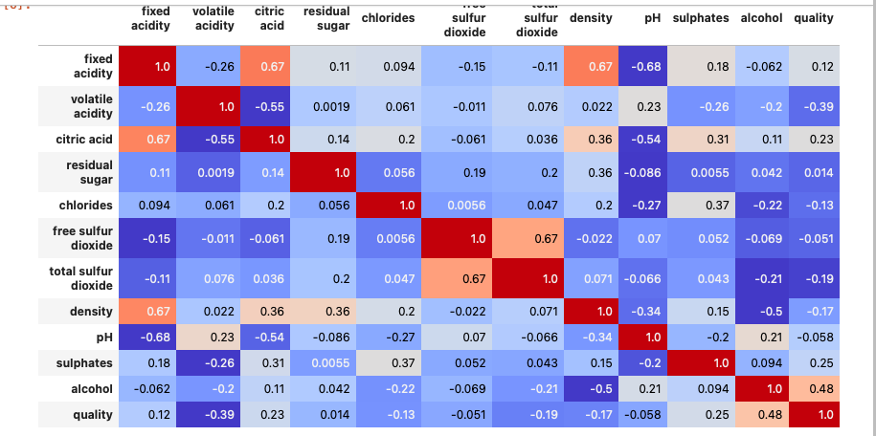
Independent Chi Square Correlation Test Results
Notes:
The results produced by the test found that Alcohol and sulphates have the least impact on quality at 0.48% and the variables that impacted quality the most were volatile acidity, chlorides, with sulfur dioxide and density following closely behind. Volatile acidity (VA) is a measure of the wine's volatile (or gaseous) acids. The primary volatile acid in wine is acetic acid, which is also the primary acid associated with the smell and taste of vinegar,chlorides being a major contributor to saltiness, Sulfur dioxide is used in winemaking as a preservative to prevent oxidation and microbial spoilage, gives an insight into the fermentation conditions and their favorability to yeast growth

Slide 17
Question 2: Which factor has the most impact on the alcohol percentage in wine ?
Initial results just from the tests run
Stepwise Regression Results - all of the variables have a direct impact except for free sulfur dioxide.

Slide 18
Question 2: Which factor has the most impact on the alcohol percentage in wine ?

Slide 19
Summary

Slide 20
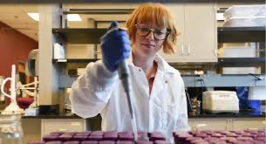
In Summary after analyzing the data and running several tests, more than simply just the sweetness, tannins and the finish contribute to what makes a quality wine. We have found that the amount of gaseous acids which impact the smell, and the resemblance of vinegar impacts the quality. Lastly the method in the winemaker uses to preserve the wine using sulfur dioxide also impacts the quality.

Slide 21
Conclusion

Slide 22
Your conclusion section should also only be one slide long. In it, you should have some bullet points containing information about: How do your findings impact the world at large? What's important about this work? Big picture information

Slide 23
Questions?

